Slide 1
Vehicle CO₂
Estimator
Estimating CO2 from car features
August 2025

Slide 2
01
THE GOAL
Learn more about data science by trying to train a model

Slide 3

BUILDING THE MODEL
PREDICT
Estimate WLTP CO₂ from vehicle specs using decision tree models.
TARGET
Mean error near 5% of the average.
If average emissions is around 150, then I wanted MAE to be around 7.5 or less.
→ 5% of 150 = 7.5
REAL WORLD PURPOSES
Financed-emissions accounting
Auto e-commerce
Regulatory compliance
Notes:
because they excel at finding non-linear patterns in structured tabular data

Slide 4
THE DATASET IN NUMBERS
10.8M
43
118K
5
REGISTRATION EVENTS (EEA, 2025)
RAW COLUMNS PER RECORD
DISTINCT VEHICLE SPECS
FEATURES USED TO PREDICT
EEA: European Environmental Agency

Slide 5
THE WORKFLOW
SPLIT FIRST
BAKE-OFF
ROUTE
Hold out 30% for validation before any exploration, so no choice peeks at test data.
Tune a decision tree, random forest and XGBoost with cross-validation.
Send each fuel type to the method that actually fits it.
2
4
6
1
3
5
DEDUPE
EXPLORE
DIAGNOSE
Pull distinct specs from 10.8M events into 118K rows, blocking identical-car leakage.
Profile distributions and missingness; drop only the rows proven wrong.
Read the worst residuals to see what the model still cannot explain.

Slide 6
02
EXPLORATION
Choosing features, reading the distribution, and anomalies

Slide 7
FEATURES & LEAKAGE
Five specs predict CO₂; leaky columns are excluded.
Fuel type (Ft): petrol, diesel, electric, hybrid and more.
Fuel consumption (Fc): CO₂ measured in litres — a direct proxy.
Mass & engine size: M in kg and Ec in cm³.
Electric energy (Z): Wh/km, defined only for electric drive.
Power & class: engine kW (Ep) and vehicle category (Cr).
Legacy emission fields: Enedc, Er… simply restate the answer.

Slide 8
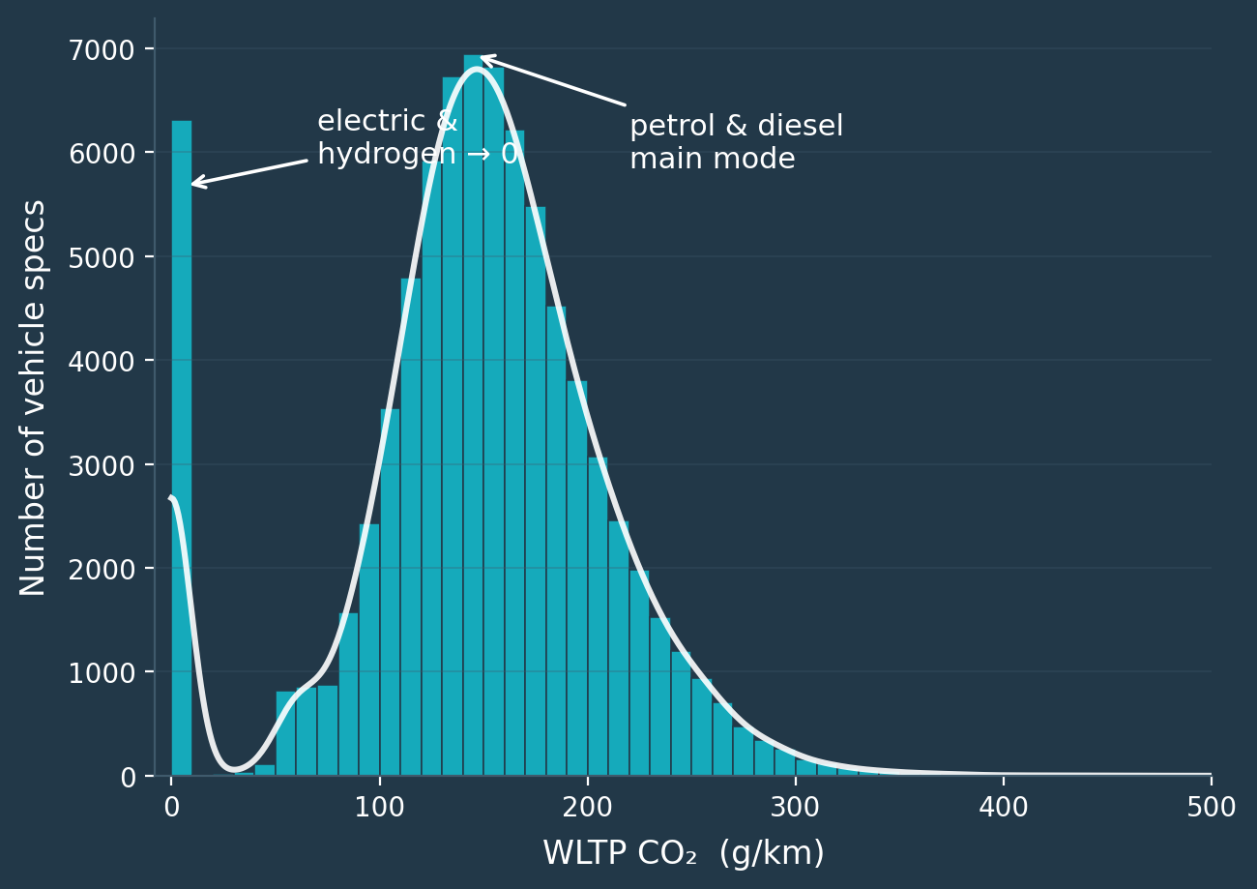
THE TARGET SHAPE
The distribution is bimodal.
A spike at 0 g/km: the electric and hydrogen vehicles.
A main mode near 140: ordinary petrol and diesel cars.
A small bump at ~57: an early hint of a data problem.

Slide 9
TWO ANOMALIES
Same investigation, opposite verdicts.
Hydrogen cars flagged: 0 g/km CO₂ with a blank engine size.
977 rows flagged: petrol/diesel at an impossible ~57 g/km.
On inspection: fuel-cells emit only water — values are correct.
On inspection: 742 share exactly 57; 98% also missing power.
Verdict — keep: valid, informative rows the model should see.
Verdict — drop: a systematic placeholder, not real data.

Slide 10
03
MODELLING
Three models, one diagnostic, and the insight that reframed the problem

Slide 11
READING THE SCORES
MAE
RMSE
R²
Mean Absolute Error — the average miss, in g/km. 'On average, off by this much.' Lower is better.
Root Mean Squared Error — also g/km, but big misses count extra, so it punishes inconsistency. Lower is better.
The share of the variation in CO₂ the model explains, from 0 to 1. Higher is better; 1.0 is perfect.
RMSE and MAE share the target’s units (g/km), so smaller means tighter. Final model: MAE 8.3, RMSE ~14, R² 0.91.

Slide 12
THE MODEL BAKE-OFF ALL FUEL TYPES
MODEL | CV RMSE | TEST RMSE | MAE | R²
Decision Tree | 20.1 | 20.0 | 9.97 | 0.913
Random Forest | 18.9 | 19.0 | 9.37 | 0.921
XGBoost ✓ | 18.7 | 18.7 | 10.06 | 0.923
Winner chosen by cross-validated RMSE. A plain linear baseline scored MAE 22.9 — the trees roughly halve that.

Slide 13
8.7% OF CARS, 86% OF THE MISSES
ALL OTHER
14%
fuel types
PLUG-IN HYBRIDS
86%
of the 50 worst errors

Slide 14
ONE FLEET, THREE PROBLEMS
COMBUSTION
ZERO-TAILPIPE
PLUG-IN HYBRID
Petrol, diesel, LPG — CO₂ tracks the hardware, so XGBoost predicts it.
Electric and hydrogen emit nothing at the tailpipe — assigned 0 g/km.
Emissions depend on charging habits no dataset sees — certified value × a real-world correction.

Slide 15
THE HYBRID CORRECTION
≥ 60 KM
40–60 KM
20–40 KM
< 20 KM
× 1.25 +25% over the label
× 1.40 +40% over the label
× 1.55 +55% over the label
× 1.70 +70% over the label

Slide 16
04
THE
RESULTS
What the clean model delivers on unseen vehicles

Slide 17
THE RESULTS
8.3
5.0%
0.91
−25%
G/KM MEAN ERROR (MAE)
OF AVERAGE EMISSIONS
R² ON HELD-OUT DATA
RMSE VS THE ALL-FUEL MODEL

Slide 18
Lessons LEARNED
DON'T MODEL EVERYTHING
RESIDUALS ARE A DETECTIVE
SPLIT BEFORE YOU LOOK
A third of the fleet — EVs and hybrids — needed rules, not regression.
Every clean-and-transform choice used training data only, keeping the test score honest.
The worst errors exposed both the fake 57 g/km rows and the hybrid problem.

Slide 19

Thanks!

